Slide 1
Sampling and Aliasing
Ed Angel
Professor of Computer Science, Electrical and Computer Engineering, and Media Arts
Director, Arts Technology Center
University of New Mexico
Angel: Interactive Computer Graphics 5E © Addison-Wesley 2009

Slide 2
Introduction
In computer graphics, we use the term “aliasing” but where does it come from?
Sampling theory explains where these errors arise and what we might do to avoid them
Explains both digitization and display
Angel: Interactive Computer Graphics 5E © Addison-Wesley 2009

Slide 3
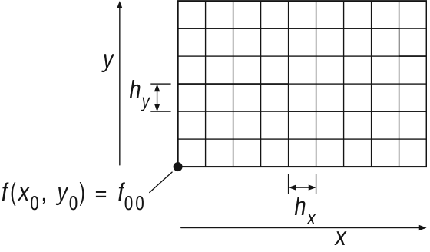
Sampling Process
Measure f(x,y) on grid
Angel: Interactive Computer Graphics 5E © Addison-Wesley 2009

Slide 4
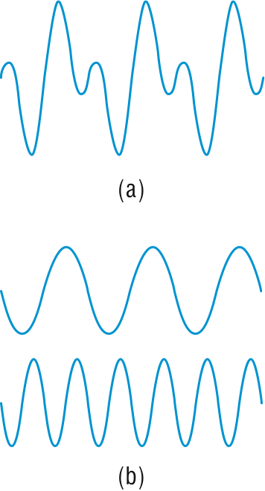
Ambiguity from Samples
Angel: Interactive Computer Graphics 5E © Addison-Wesley 2009

Slide 5
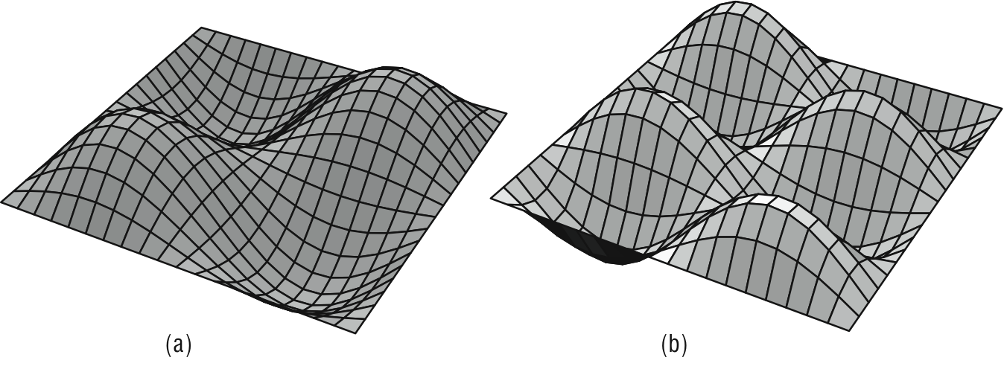
Basis Images
Angel: Interactive Computer Graphics 5E © Addison-Wesley 2009

Slide 6
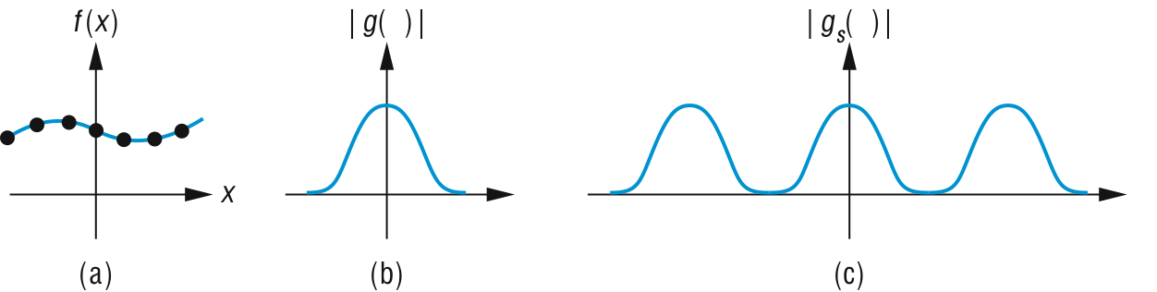
Sampling and Replication
Angel: Interactive Computer Graphics 5E © Addison-Wesley 2009

Slide 7
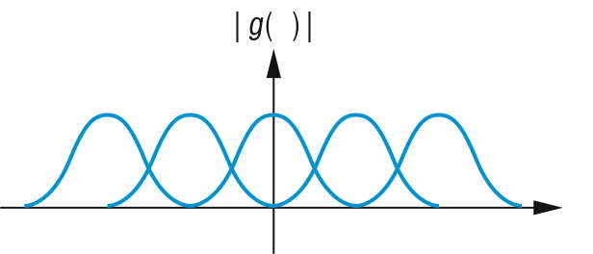
Replication with Overlap
Angel: Interactive Computer Graphics 5E © Addison-Wesley 2009

Slide 8
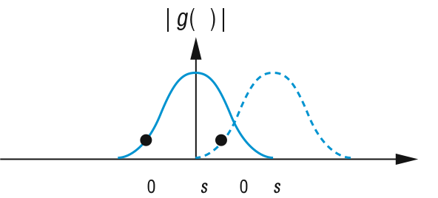
Aliasing
Angel: Interactive Computer Graphics 5E © Addison-Wesley 2009

Slide 9
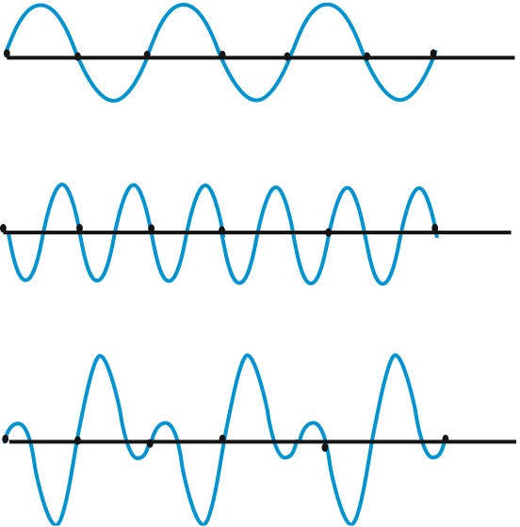
Angel: Interactive Computer Graphics 5E © Addison-Wesley 2009

Slide 10
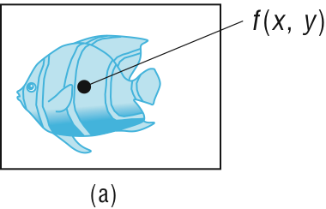
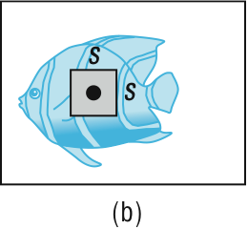
Sampling
point sampling
area sampling
Angel: Interactive Computer Graphics 5E © Addison-Wesley 2009

Slide 11
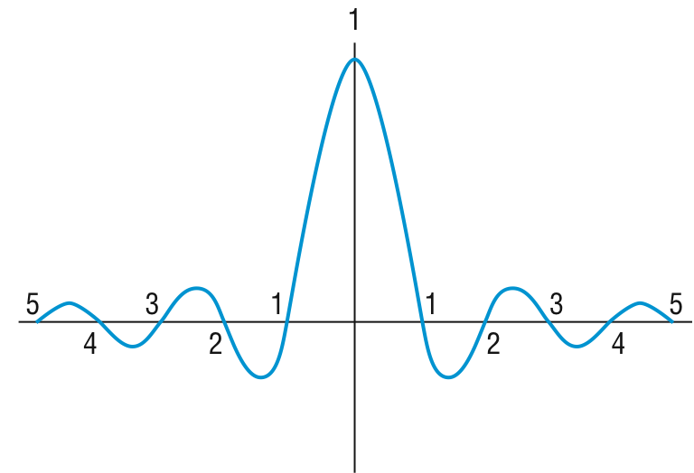
Sinc function
Angel: Interactive Computer Graphics 5E © Addison-Wesley 2009

Slide 12
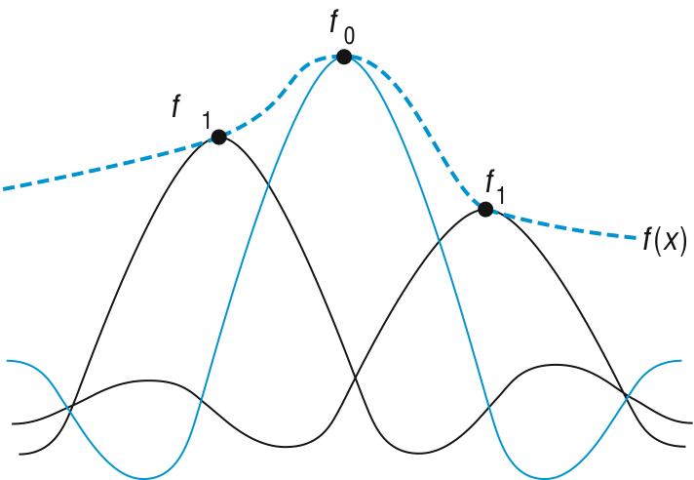
Reconstruction with Sinc
Angel: Interactive Computer Graphics 5E © Addison-Wesley 2009

Slide 13
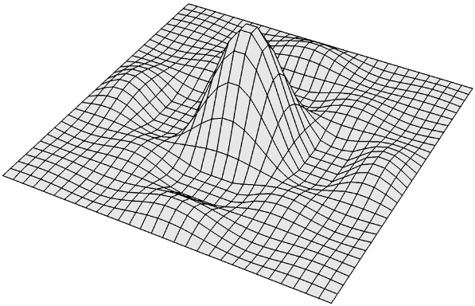
Two dimensional sinc
Angel: Interactive Computer Graphics 5E © Addison-Wesley 2009

Slide 14
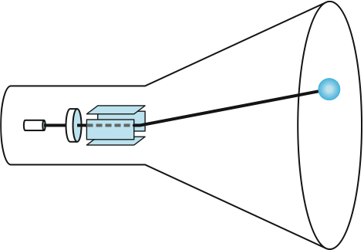
Point Spread of CRT Beam
Angel: Interactive Computer Graphics 5E © Addison-Wesley 2009

Slide 15
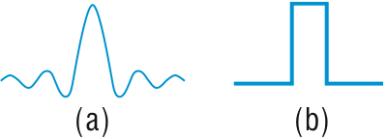
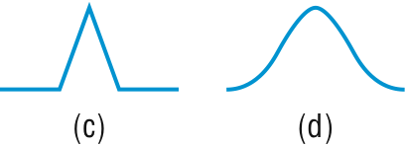
Reconstruction functions
sinc
rectangle
triangle
Gaussian
Angel: Interactive Computer Graphics 5E © Addison-Wesley 2009

Slide 16
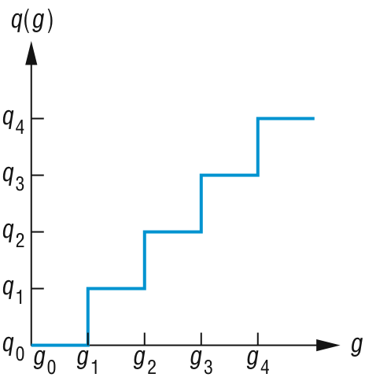
Quantizer
Angel: Interactive Computer Graphics 5E © Addison-Wesley 2009

